Slide 1
EE515 Project
Waveguide Filter
Joseph Filbert, Justin L, Johnathan L

Slide 2
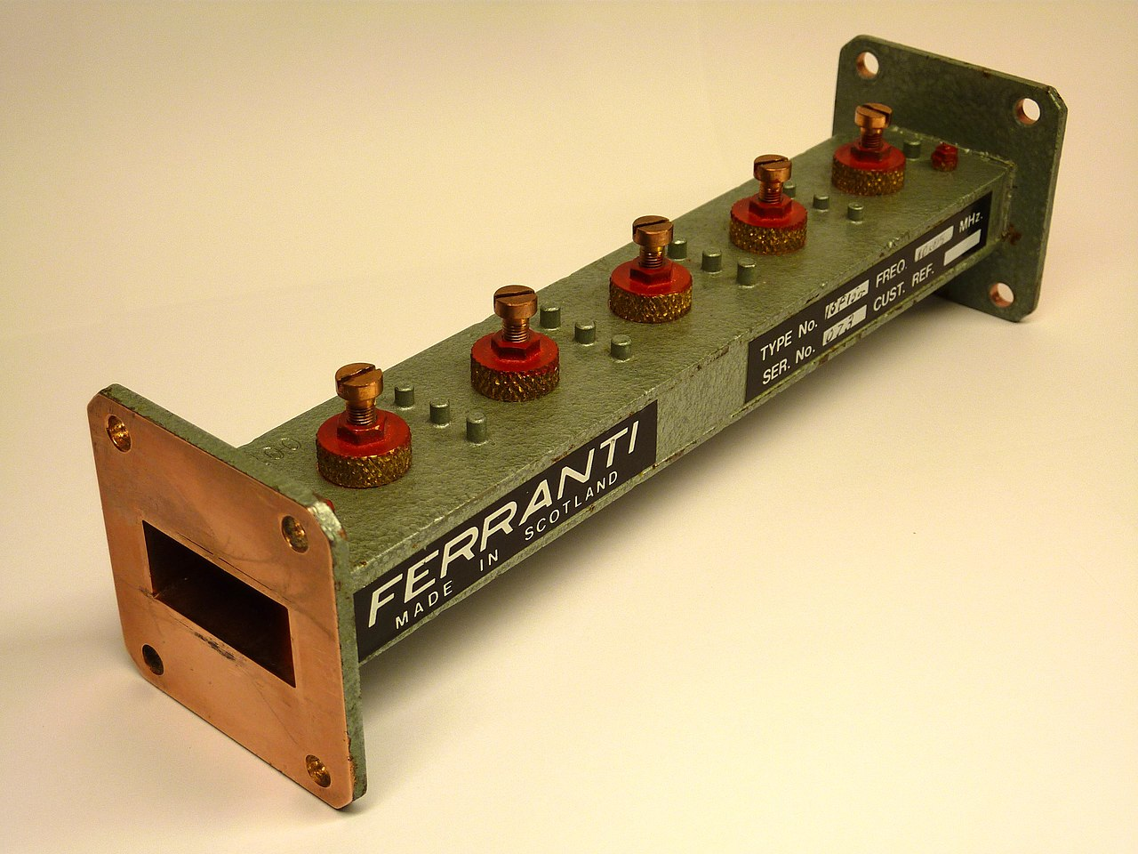
Waveguide Filter & Goals
What is it?
A filter constructed in a waveguide
How does it work?
It utilizes posts that act as LC circuit
Goals of the project
Develop a post based waveguide filter
10 GHz center frequency
200 MHz bandwidth
Measure the performance of the waveguide filter
Asses performance to the theoretical filters
Refinements in manufacturing techniques
Image courtesy of wikipedia

Slide 3
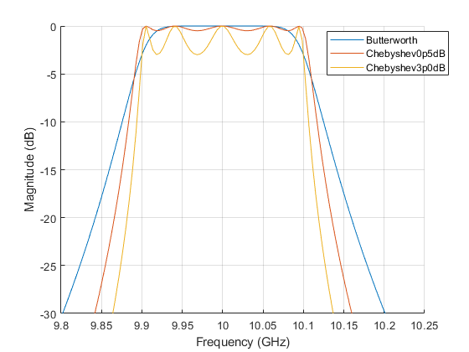
Ideal Filters
Initially designed with insertion loss method with Pozar
Found issues in agreement with bandwidth limitations using lumped components
Designed with Matlab rf toolbox
5th Order Filters Considered
Butterworth
Chebyshev .5 dB
Chebyshev 3 dB

Slide 4
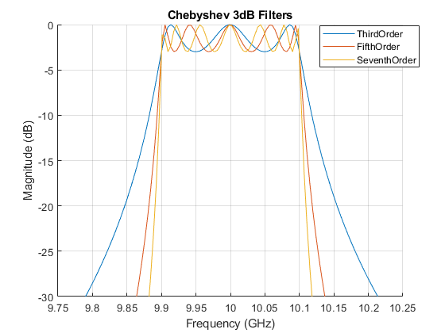
Ideal Filters - Order
Each filter requires n+1 posts
Consider
3rd
Long ripple
Few posts
5th
Reasonable post amount
Closer to frequency range
7th
Many posts required
Harder to manufacture
Best frequency range tracking

Slide 5
Ideal Filters- Decision
Chebyshev 3dB was chosen
Butterworth
Didn’t capture the BW as well
Chebyshev .5dB
More sensitive to manufacturing

Slide 6
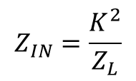
Lumped Element Prototype Conversion
Waveguide discontinuities and transmission lines are distributed elements
Series elements in waveguides are difficult to implement, discontinuities and obstructions are shunt equivalent components
Intelligent use of Impedance or admittance inverters can reduce filter complexity
K
Z_{L}
C
L

Slide 7
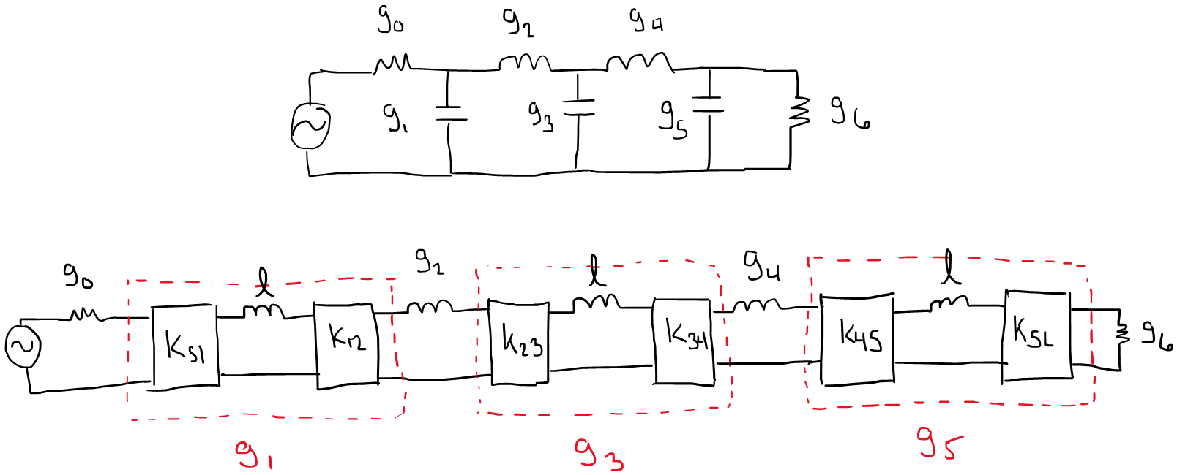

Slide 8
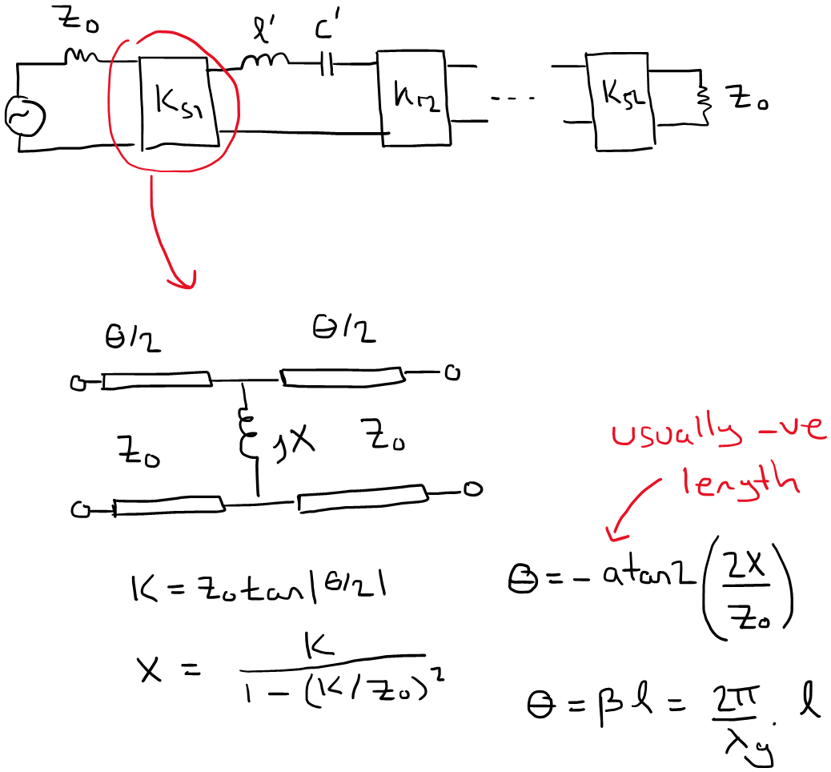

Slide 9
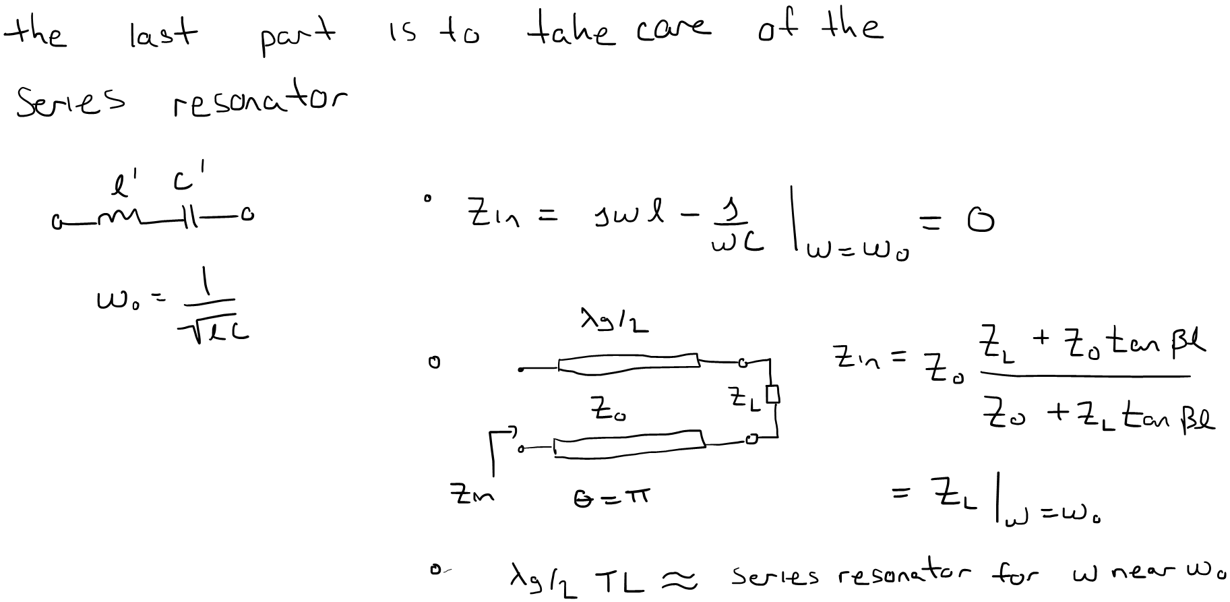

Slide 10
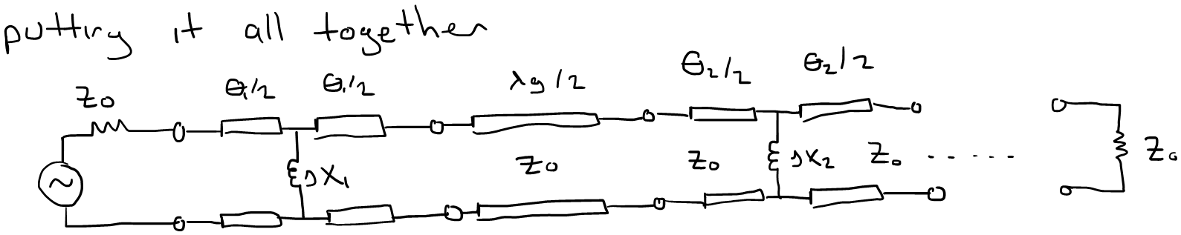
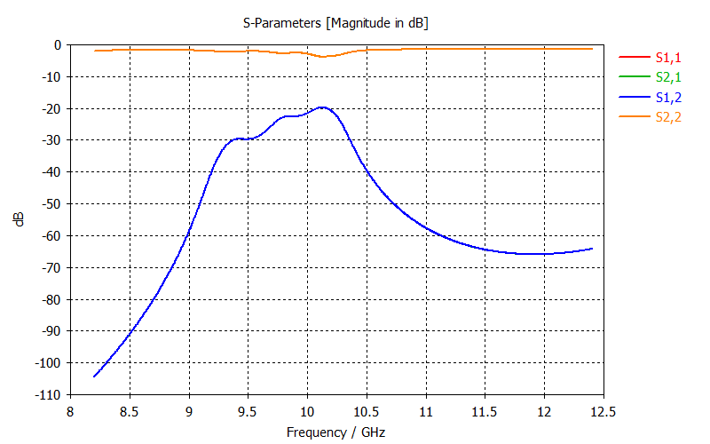
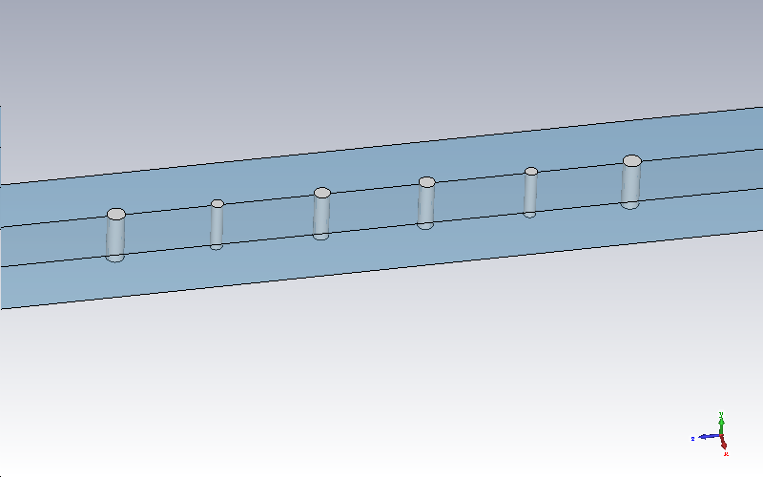

Slide 11
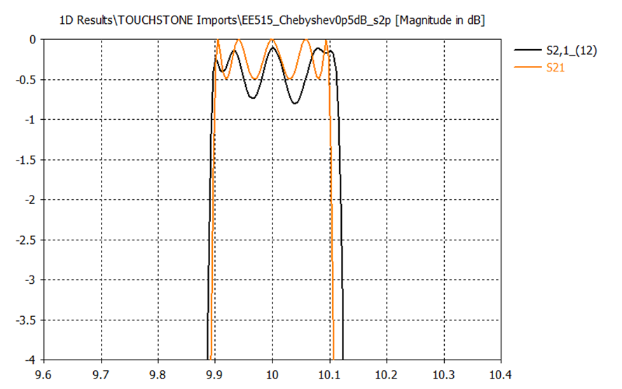
CST Optimization
Final dimensions are:
l3 23.162 mm d3 6 mm
l2 22.835 mm d2 5.5 mm
l1 20.353 mm d1 2.5 mm

Slide 12
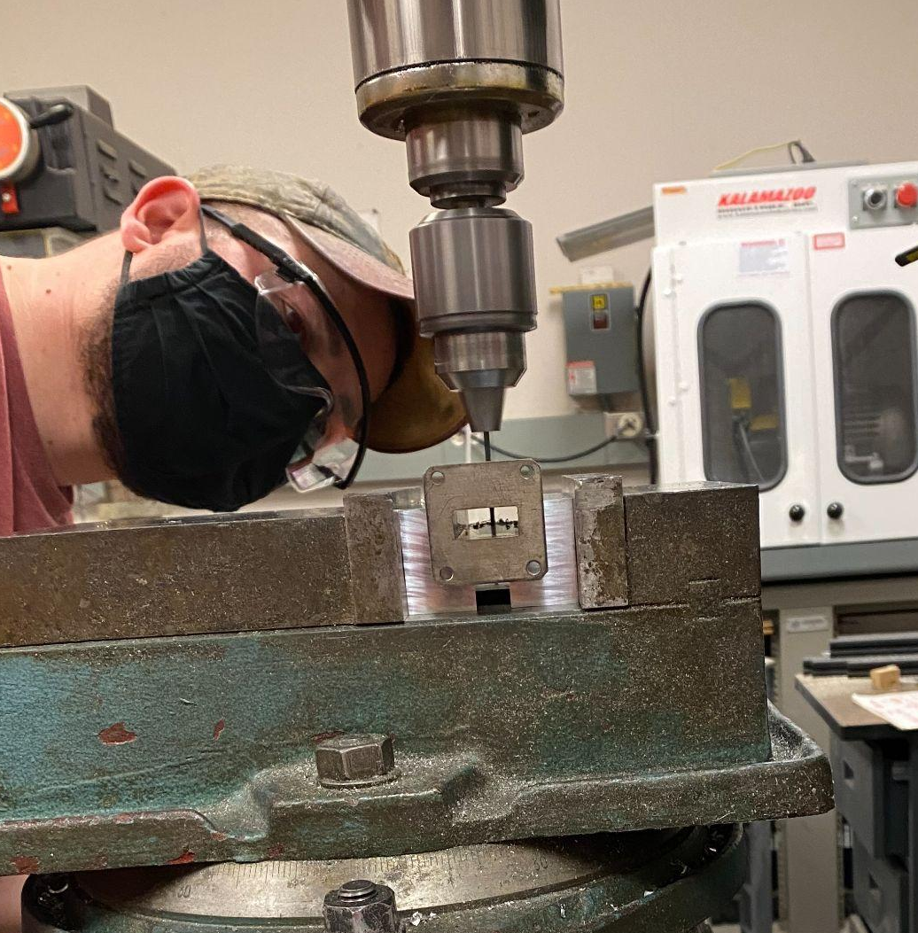
Manufacturing
Removal of enamel paint
Manufacture on mill
Create reference plane
Drill holes
Deviation from model distances
Mill tolerances
Machine posts from brass
High temp propane source soldering
Thermal conductivity and heat capacity
Protective enamel coat applied

Slide 13
Filter Analysis
Used MATLAB to compare real and ideal filters
Used rffilter() in RF Toolbox to create ideal filter
Imported s2p files to simulate real filter
Important Parameters
Center Frequency
3 dB Bandwidth
Change in phase response
More qualitative

Slide 14
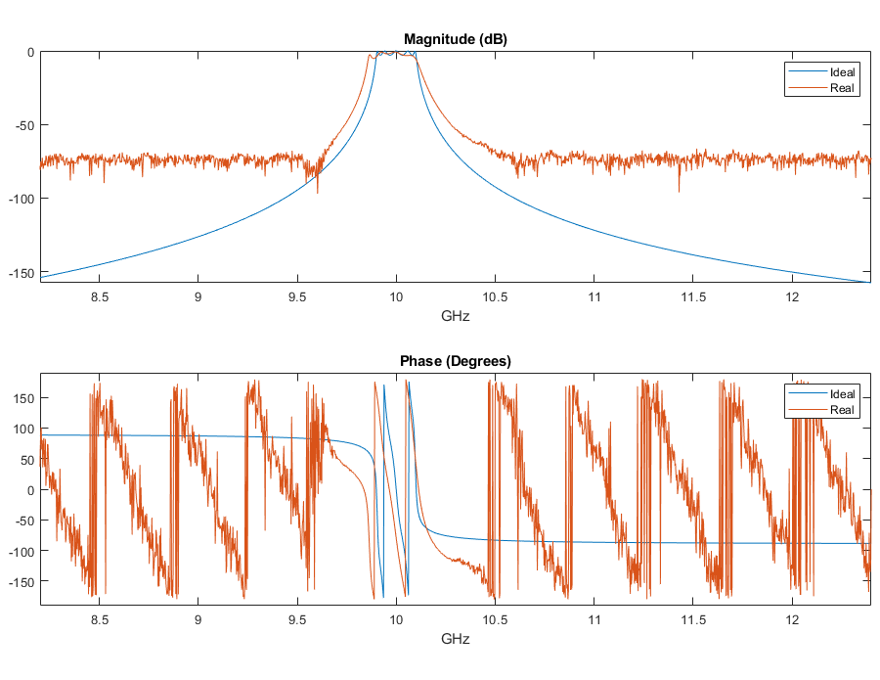
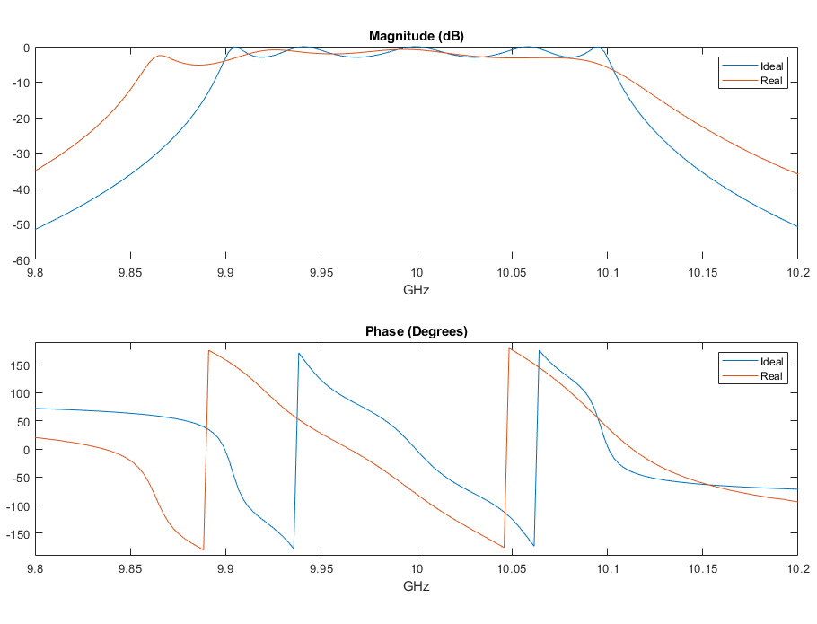
Filter Analysis - Frequency Response

Slide 15
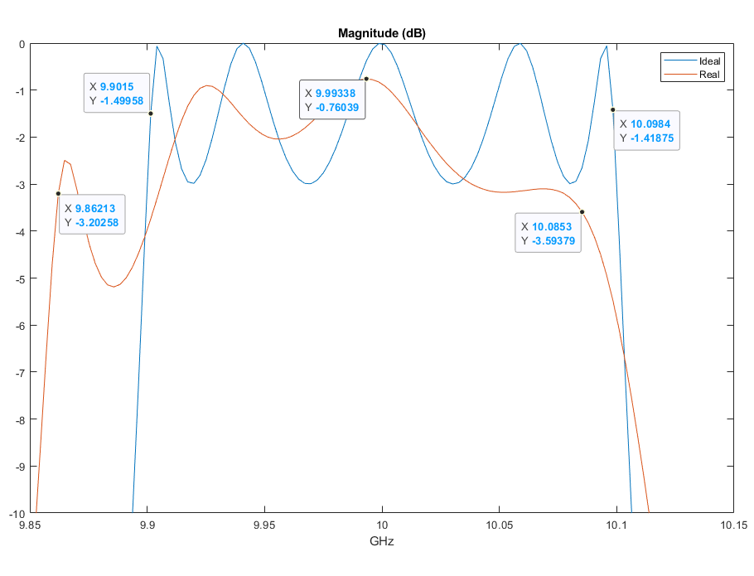
Filter Analysis - Resulting Parameters
Center frequency: 10 GHz
Bandwidth: About 225 MHz
Phase and magnitude response are shifted to lower frequency

